Slide 1
PROCESS CONCEPT
REFERENCES:
“OPERATING SYSTEM CONCEPTS” 9TH EDITION BY ABRAHAM SILBERSCHATZ, PETER BAER GALVIN AND GREG GAGNE
“OPERATING SYSTEMS: INTERNALS AND DESIGN PRINCIPLES”, 7TH EDITION BY WILLIAM STALLINGS
NPTEL lectures on “Introduction to Operating Systems” by Prof. Chester Rebeiro, IIT Madras https://nptel.ac.in/courses/106106144/

Slide 2
WHY WE NEED OPERATING SYSTEMS
Programmers develop applications to perform some task over computer.
It is not efficient to write applications for a particular hardware platform.
OS act as secure and efficient interface between the applications and the hardware resources.
OS provides a uniform access to resources when requested by applications

Slide 3
WHAT DOES OS MANAGES?
It provides resources to multiple applications
It helps multiple applications to use processor simultaneously by switching processor among applications.
All applications make progress concurrently.
It helps in efficiently sharing Processor and I/O devices among applications.

Slide 4
Define PROCESS?
It is an instance or a portion of a program which is getting executed in the processor at the moment
Executing a process means executing instructions in a sequence.
Each process has a current state, and a set of system resources acquired by it

Slide 5
PROCESS CONCEPT
Types of systems
Batch system: Where computational tasks are completed by processors in the form of Jobs.
Time-shared systems: Processor is shared among applications.
process can also be termed as job
A program is not a process.
A program is a passive entity, for example a ﬁle with a list of instructions stored on disk.
Whereas, a process is an active part of a process.
A program counter specifies the next instruction to execute and a set of associated resources.
When an executable ﬁle is loaded into RAM, the program becomes a process.

Slide 6
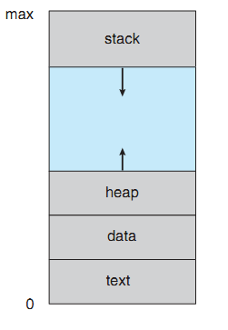
A Process in Memory
A Process consists of following sections in the memory:
The code or instructions, also called text section
Program counter and registers maintain current activities of a process
Stack stores temporary data of a process.
For example local variables, function arguments or return addresses
Data section stores global variables
Memory allocated dynamically during run time is stored in Heap
A process in memory
Figure 3.1 in Ref.1

Slide 7
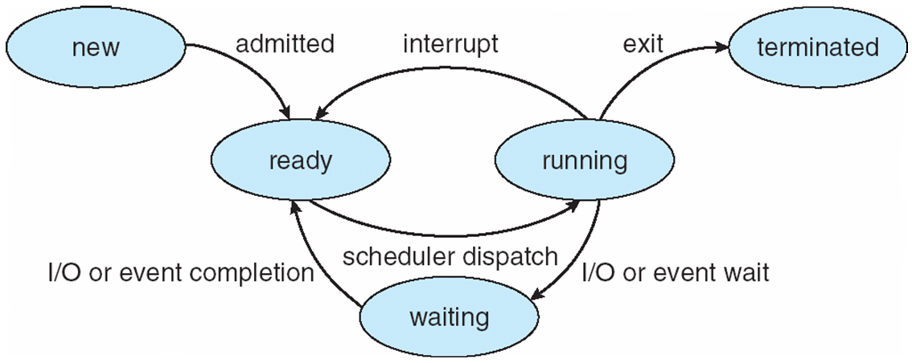
STATES OF A PROCESS
During execution, a process is in one of the mentioned states:
New: When a process is being created.
Waiting: When the process is waiting for some I/O resource or an event to occur like getting input from keyboard, a message from another process, to access disk storage or an another process to finish a task, and so on.
Ready: The process is in queue having all the required resources and waiting to get a processor
Running: When CPU is executing process instructions
Terminated: When process finishes execution of all its instructions

Slide 8
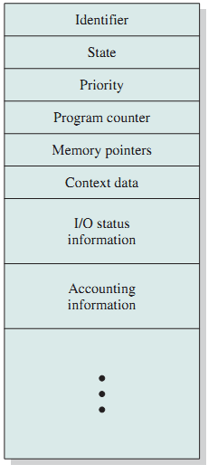
WHAT IS A PROCESS CONTROL BLOCK (PCB)
Each process has a PCB or a Task Control Block.
Each process can be uniquely identified by a no. of parameters
A process execution can be interrupted and later resumed
It stores process specific information, like
State: State of a process can be ready, waiting, running, etc
Program counter: It stores location of next instruction to execute
CPU scheduling: it provides relative priorities of process and pointers to queue
CPU registers: It stores information/ data associated with process
Fig. 3.1 from Ref. 2

Slide 9
PROCESS CONTROL BLOCK (CONTD.)
Memory-management information: Size of memory and starting address allocated to the process
Usage/Accounting information: CPU utilization, turn around time, etc
I/O status: resources or devices allocated to a process
Identifier: Each process has a unique id
Memory pointers: It stores the address of the program code and data related to process
Priority: Priority of a process compared to other

Slide 10
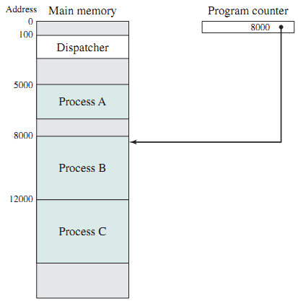
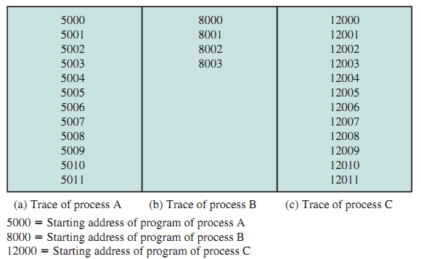
TRACE AND DISPATCHER
TRACE monitors and notes execution sequence of instructions. It also keeps record of process interleaving while executing.
DISPATCHER is a small program in operating system that helps in switching processor the from one process to another
Fig. 3.2 and 3.3 from Ref.2

Slide 11
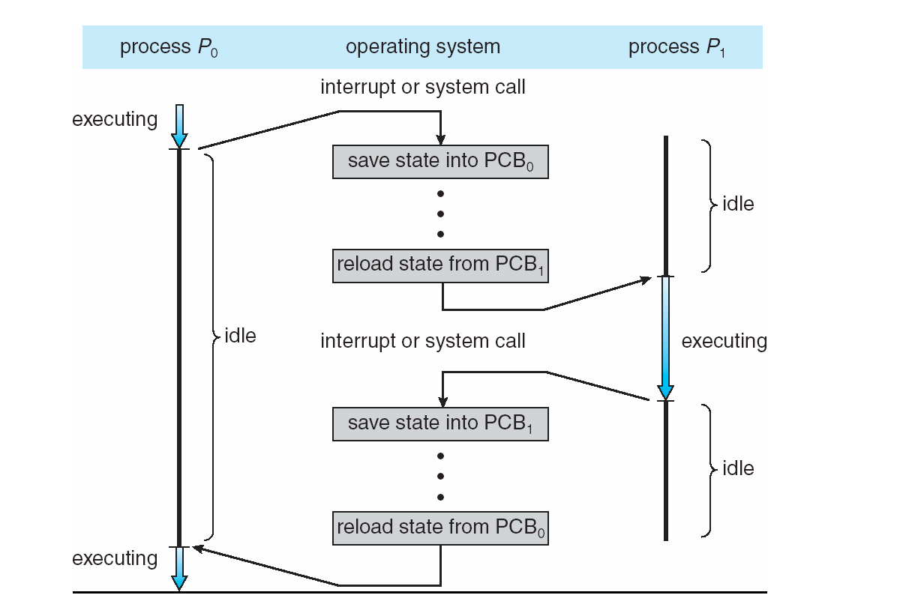
SWITCHING Between PROCESSES
Fig. 3.4 from Ref.1

Slide 12
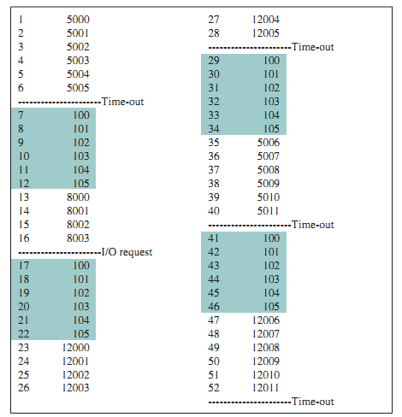
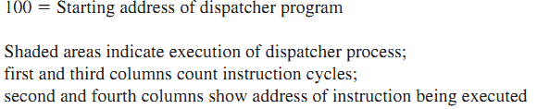
Fig. 3.4 from Ref.2

Slide 13
THREADS
A process can be divided into multiple light weight executable entities to parallelize the task.
These are called Threads.
Suppose a process consists of multiple program counters (PC)
Code of a process can be executed from multiple locations or instructions

Slide 14
PROCESS SCHEDULING
Multiple processes share same CPU in time sharing systems
It is required to maximize CPU utilization
A process should not hold processor while it is busy some other tasks like I/O activity.
A quick processes switching is required onto CPU

Slide 15
PROCESS SCHEDULING
A Process scheduler selects the next process for execution on CPU while multiple are available to run
It maintains scheduling queues of processes
I/O or Device queues: consist of processes waiting to get access to an I/O device
Ready queue: It is a queue of processes which are waiting in main memory to execute in CPU
Processes switches from one queue to another

Slide 16
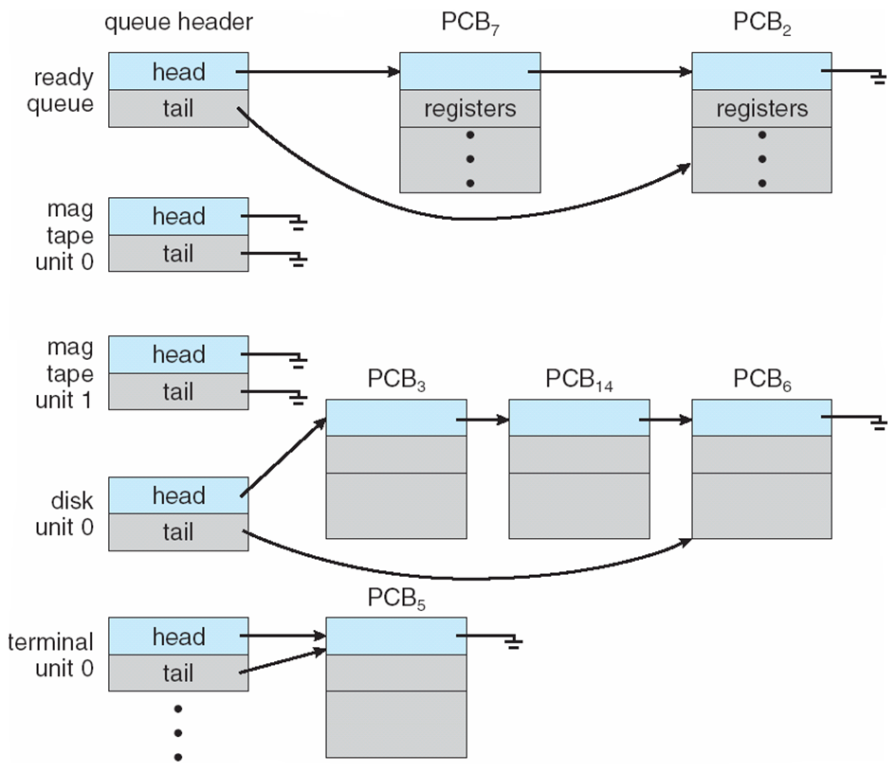
READY QUEUE AND VARIOUS I/O DEVICE QUEUES
Fig. 3.5 from Ref.1

Slide 17
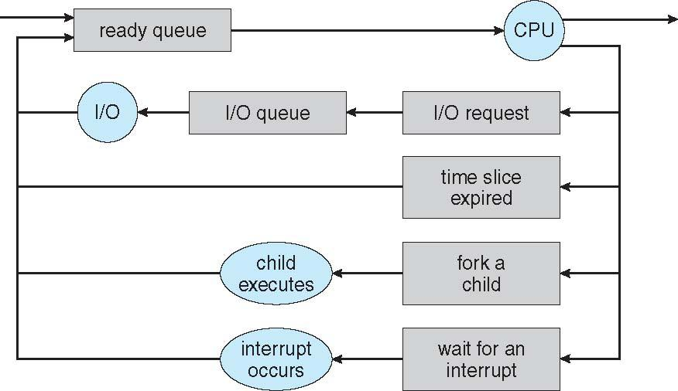
QUEUEING DIAGRAM
Fig. 3.6 from Ref.1

Slide 18
SCHEDULERS
Processes are usually stored to a secondary storage device (like a disk) for later execution
For execution OS brings them to main memory (RAM)
Processes are classified as:
I/O-bound process – These processes majorly spends time performing I/O activities than doing computations using CPU
CPU-bound process – – These processes majorly perform computations using CPU
The portion of the OS responsible for selecting processes to be brought to main memory/ ready queue is Long-term scheduler (or job scheduler).
It is called less-frequently (like in seconds, minutes)
It decides the degree of multiprogramming
It should select a proper combination of I/O bound and CPU bound processes

Slide 19
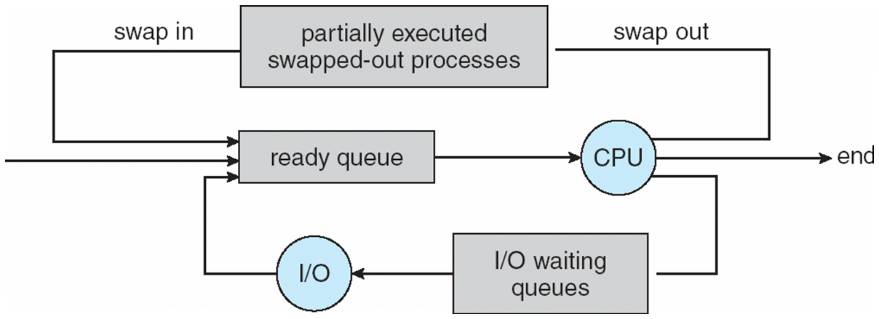
SCHEDULERS (CONTD.)
The portion of the OS responsible for selecting processes which can be executed next in CPU is called Short-term scheduler (or CPU scheduler)
Few system have only this scheduler
It is called frequently (like in milliseconds)
Medium-term scheduler: It can used to reduce the degree of multiple programming.
It performs swapping of processes. It swaps processes from memory to disk and vice-versa
Fig. 3.7 from Ref.1

Slide 20
CONTEXT SWITCH
Sometimes OS interrupts CPU from performing its current task to run a kernel routine
Or CPU switches to another process when CPU usage of one process is either complete or interrupted
Context switching means saving the current state of a running process so that it can be restored.
It helps in saving the state of the old process and loading the saved state for the new process
PCB provides the Context/state of a process
Context-switch time is an overhead; not a useful work for the system
Complex OS and PCB increases the switching time
Time also depends on hardware support

Slide 21
OPERATIONS ON PROCESSES
System must provide mechanisms for:
process creation,
process termination,
and so on

Slide 22
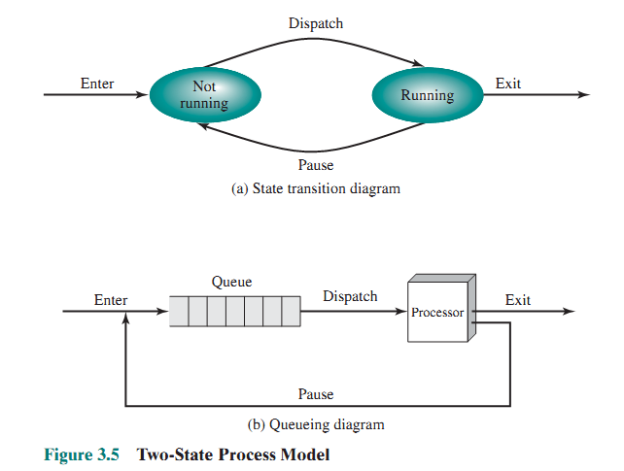
TWO-STATE DIAGRAM
Ref.2

Slide 23
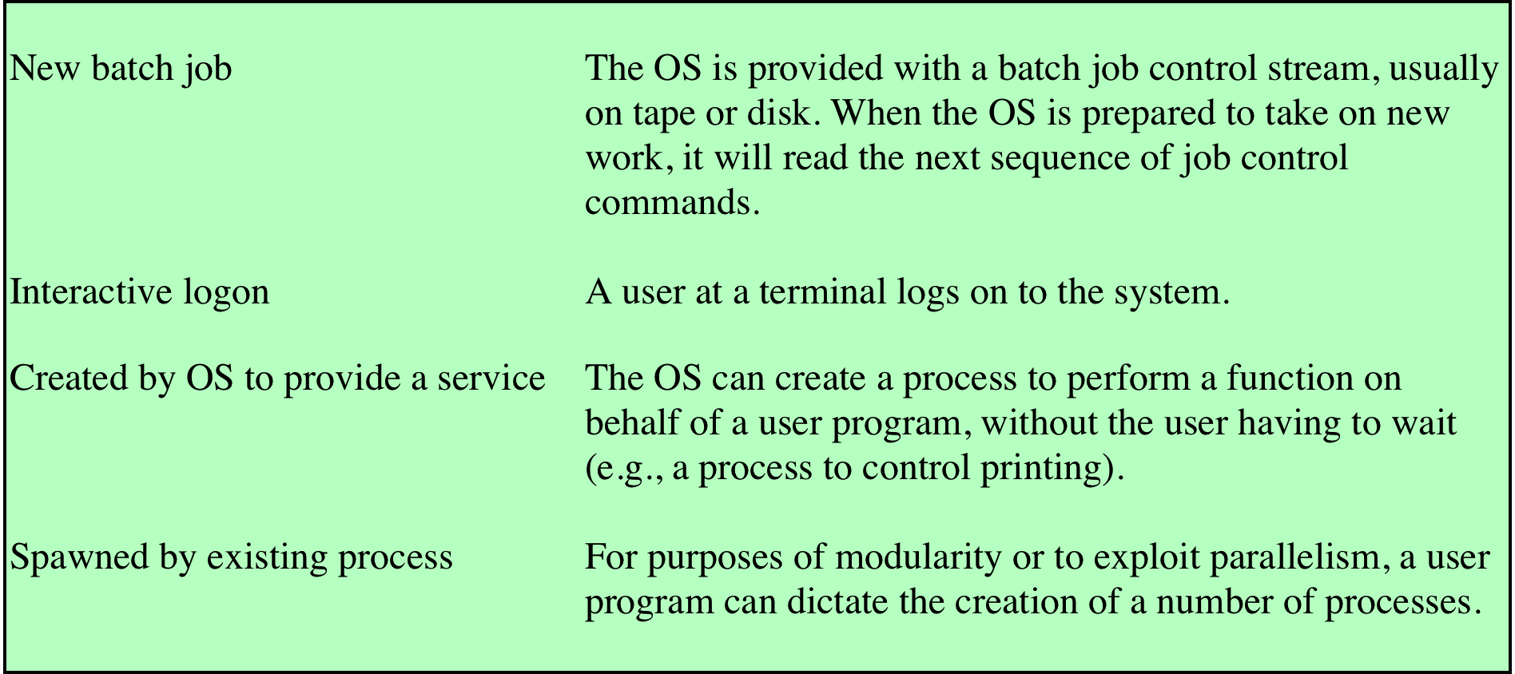
REASONS FOR PROCESS CREATION
Or when a process requests the OS to create another process
Table 3.1 from Ref.2

Slide 24
PROCESS CREATION
A process can create another process by requesting OS.
These processes are called Parent process and children processes, respectively.
This may result in creating a tree of processes
Each process has a unique process identifier (pid)
Resource Sharing
A Parent process has to distribute its resources among its children
It prevents any process from creating too many child processes as it may overload the system
A child process can acquire its resources either from its parent or directly from the operating system

Slide 25
PROCESS CREATION
Process Execution
Parent and children processes may execute simultaneously
Parent waits to terminate until all its children terminate
Address-space options for the new process
A child process is a copy of its parent process.
They both have same program and data

Slide 26
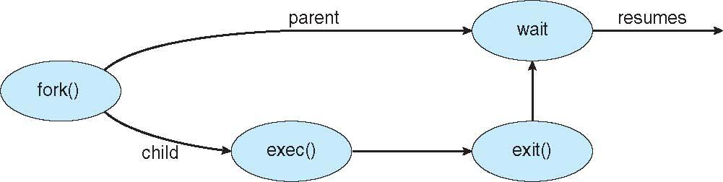
CREATING PROCESS IN UNIX
fork(): This system call creates new process
The parent and the child both continue the execution starting from the instruction just after the fork()
Fork returns 0 to the child process and pid of child to the parent
exec(): After a fork(), the parent or the child process uses the exec() system call to replace the memory space of process with a new program
Parent can use wait() to leave the ready queue until its children terminate

Slide 27
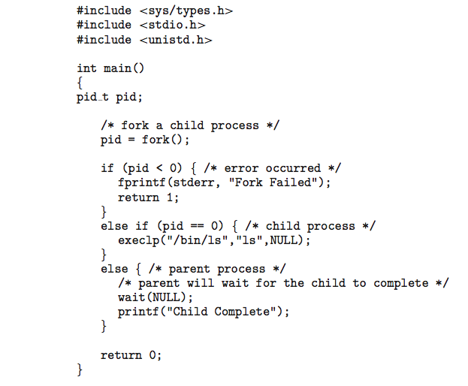
C PROGRAM FORKING SEPARATE PROCESS
Figure 3.9 Creating a separate process using the UNIX fork() system call Ref.1

Slide 28
PROCESS TERMINATION
Methods available to terminate a process:
HALT instruction or an explicit OS service call can be used for termination
Close or Logoff application
Unix uses exit() system call
Parent process receives a status value from child process using wait() system call
Resources of the terminating process are deallocated like I/O buffers, files, physical and virtual memory

Slide 29
PROCESS TERMINATION
abort(): Parents can use it to terminate the execution of children processes
Reasons:
When child exceeds allocated resources
No utility of child and it assigned task
Parent wants to terminate and the operating systems does not allow a child to continue if its parent terminates
Cascading termination: Termination of a process leads to the termination of all its children and grandchildren
Exit() returns status information and the pid of the terminated process
pid = wait(&status);
If no parent waiting (i.e. did not invoke wait()) then child process becomes Zombie
If parent terminated without invoking wait , process becomes Orphan

Slide 30
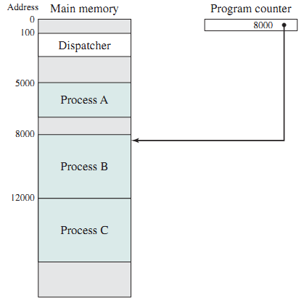
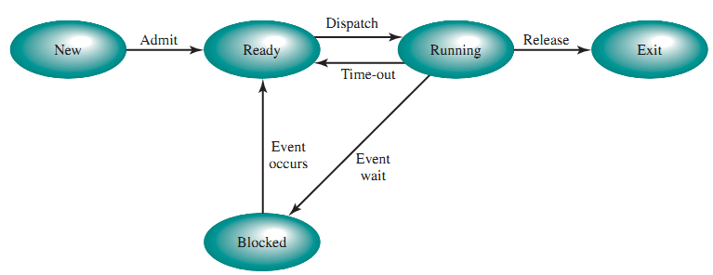
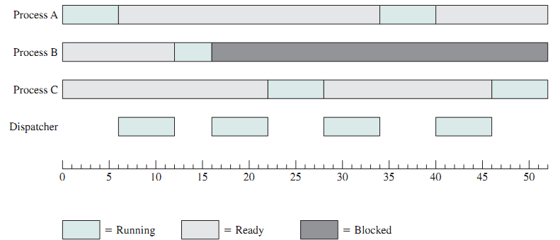
FIVE-STATE DIAGRAM
Figure 3.6 and 3.7 from Ref.2

Slide 31
SUSPENDED PROCESSES
Swapping
Scenario: Ready queue is full. Processes in ready queue are blocked and waiting to complete an I/O activity. Processor is idle.
Solution: No processes in main memory are in the Ready state, the OS swaps one of the blocked processes out on to disk into a suspend queue
After swapping-out operation, OS has two choices:
Bring a newly created process into main memory
Or bring in a previously suspended process.

Slide 32
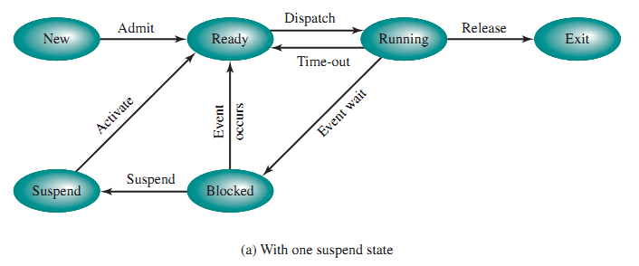
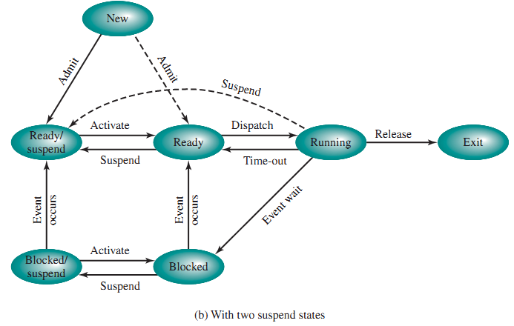
from Ref.2

Slide 33
Running to Ready/Suspend: Time allocation expires OR a higher-priority process on the Blocked/Suspend queue gets unblocked
Blocked to Blocked/Suspend: No ready processes available OR currently running process or a ready process about to dispatch requires more main memory
Blocked/Suspend to Blocked: A process in the (Blocked/Suspend) queue is having higher priority over the processes in the (Ready/Suspend) queue and OS assumes unblocking event will occur soon.
Blocked/Suspend to Ready/Suspend: The event for which it has been waiting occurs
Ready/Suspend to Ready: there is no ready process in main memory OR a process in the Ready/Suspend state has higher priority than the processes in the Ready state.
Ready to Ready/Suspend: Normally, not preferred. Needed to free up a sufficiently large block of main memory. Might also suspend a lower-priority ready process rather than a higher priority blocked process
New to Ready/Suspend: Insufficient room in main memory for a new process

Slide 34
INTERPROCESS COMMUNICATION
Types of Processes: Independent or Cooperating
Cooperating: It can affect or be affected by the other processes and share data with other process
Need for cooperating processes:
Modularity
Convenience
Computation speedup
Information sharing
Cooperating processes need Interprocess Communication (IPC)
Why Cooperation?
Information sharing: Several users may be interested in the same information
Computation speedup
Modularity: dividing the system functions into separate processes or threads
Convenience

Slide 35
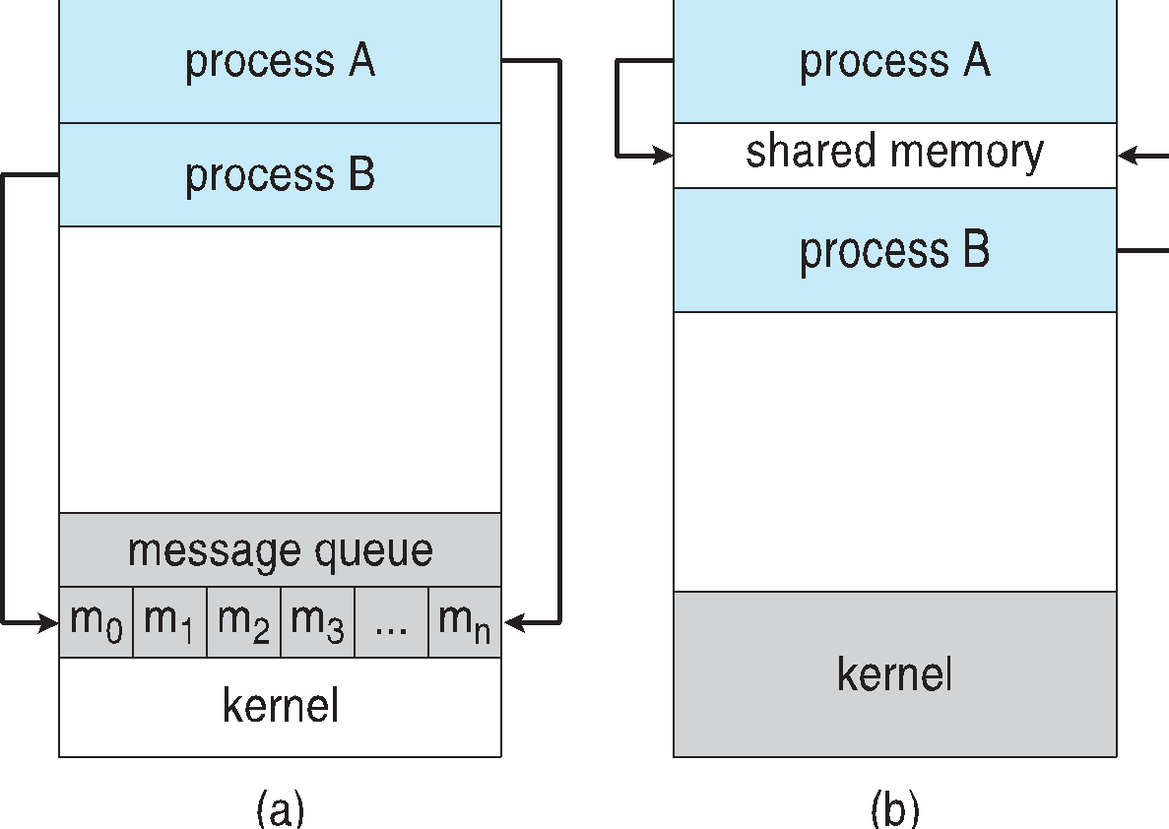
IPC Mechanisms
Shared memory
Message passing
Signals
(a) Message passing (b) shared memory
Many systems implement both shared memory and message passing

Slide 36
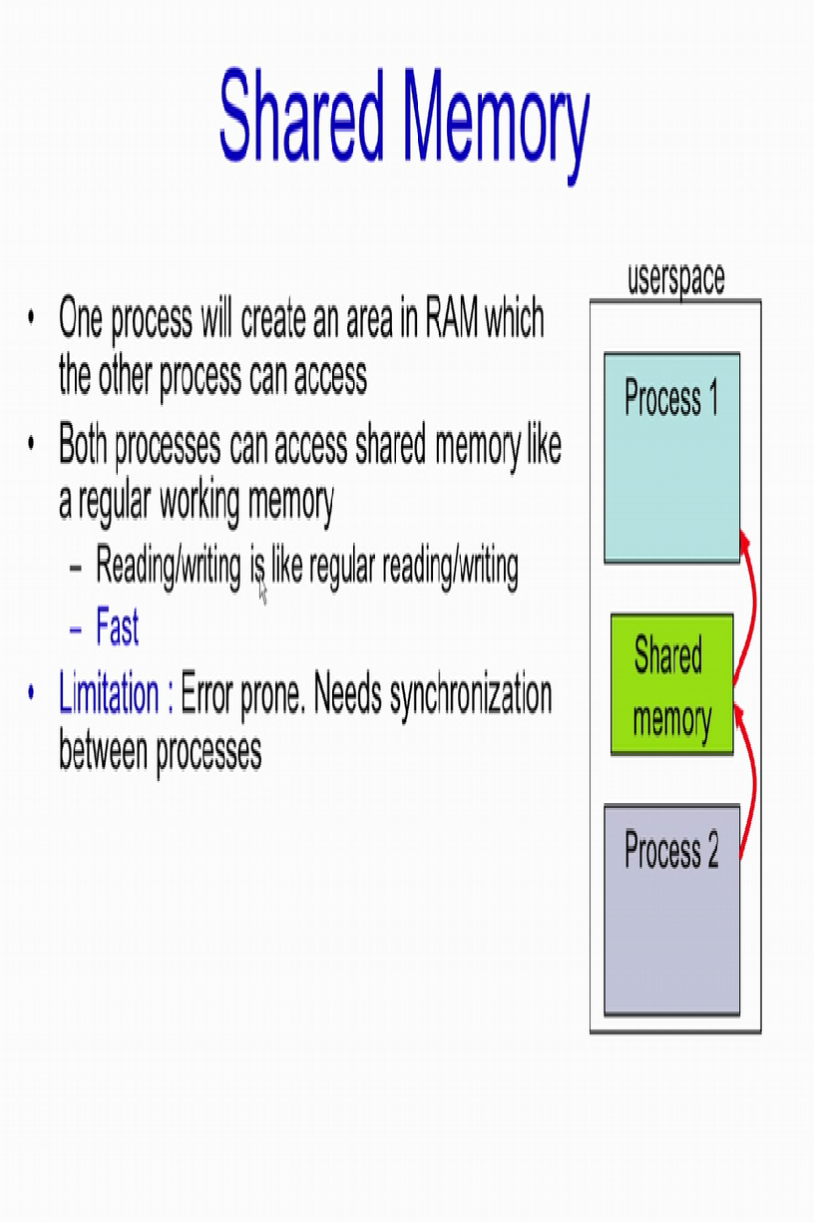
SHARED MEMORY
One process reserves an area in the RAM that is accessible by another process.
Advantage: Fast access- similar to regular reading and writing in the memory
Disadvantage: Needs process synchronization

Slide 37
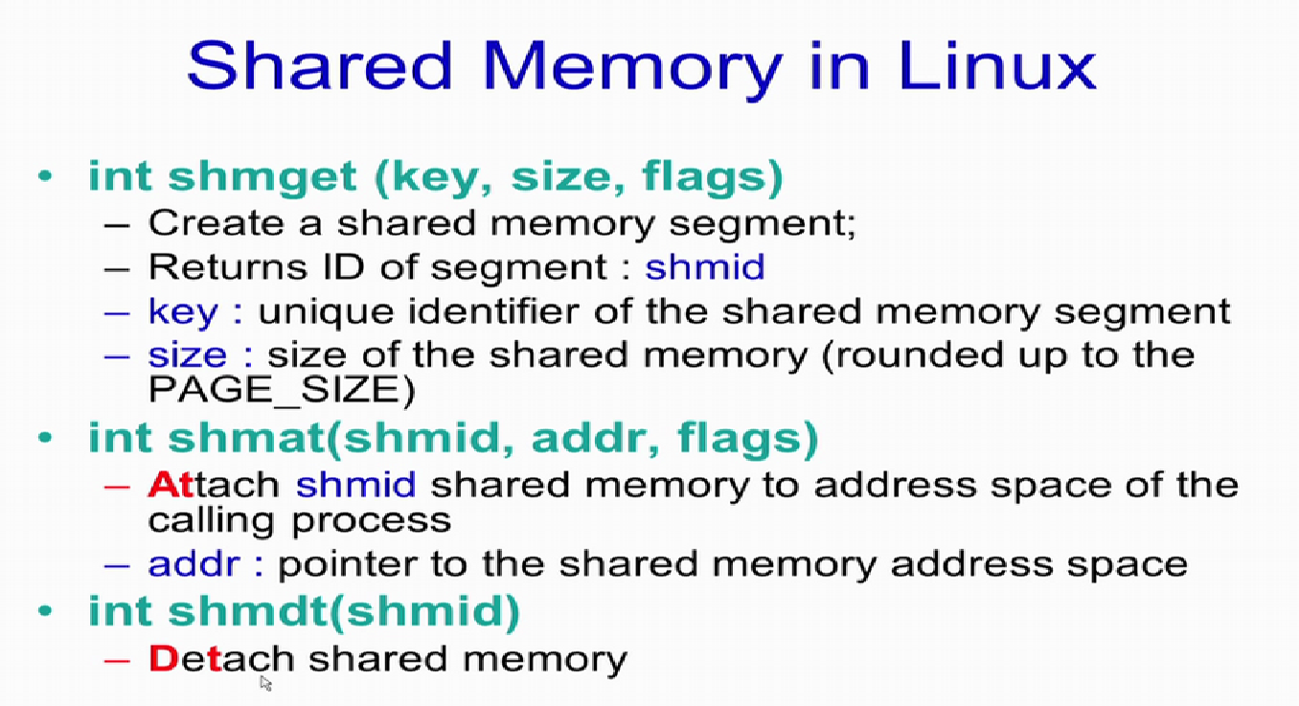

Slide 38
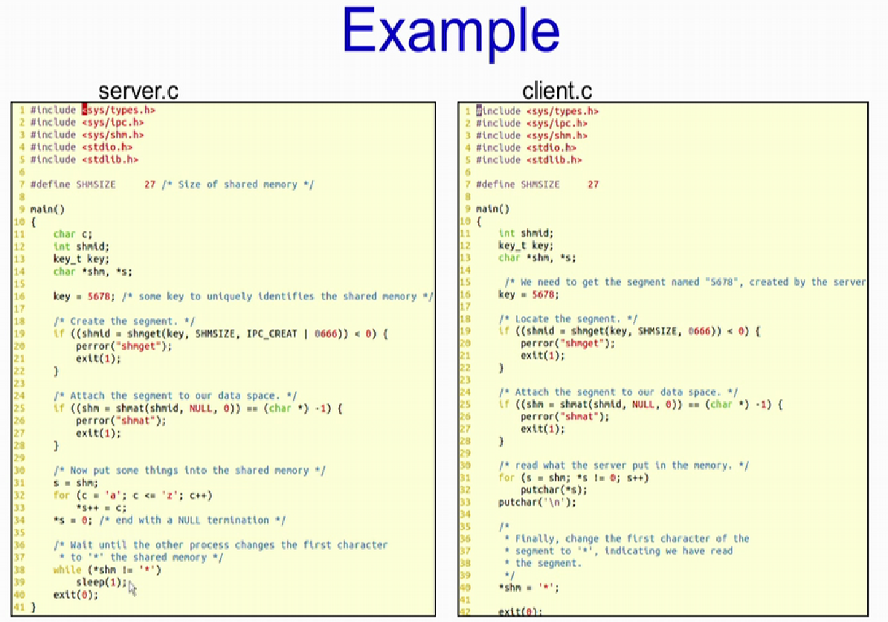

Slide 39
Problems with Shared memory:
Normally, OS tries to prevent one process from accessing another process’s memory.
Shared memory requires to remove this restriction.
Processes are also responsible for ensuring that they are not writing to the same location, simultaneously.
Producer –Consumer Problem Example: A web server produces HTML files and images, which are consumed by the client browser.
Solution: A shared buffer that can be filled by the producer and emptied by the consumer

Slide 40
SHARED MEMORY: PRODUCER-CONSUMER PROBLEM
A producer process produces information which is consumed by a consumer process.
Both share a common buffer which can be of two types:
unbounded-buffer: Unlimited size of buffer
bounded-buffer: limited buffer size

Slide 41
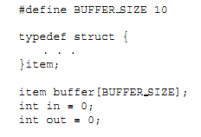
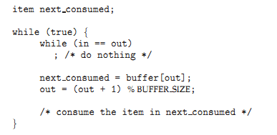
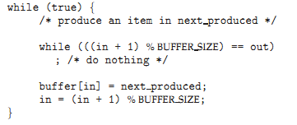
SOLUTION WITH BOUNDED-BUFFER
Producer Consumer
Figure 3.13 and 3.14 from Ref.1

Slide 42
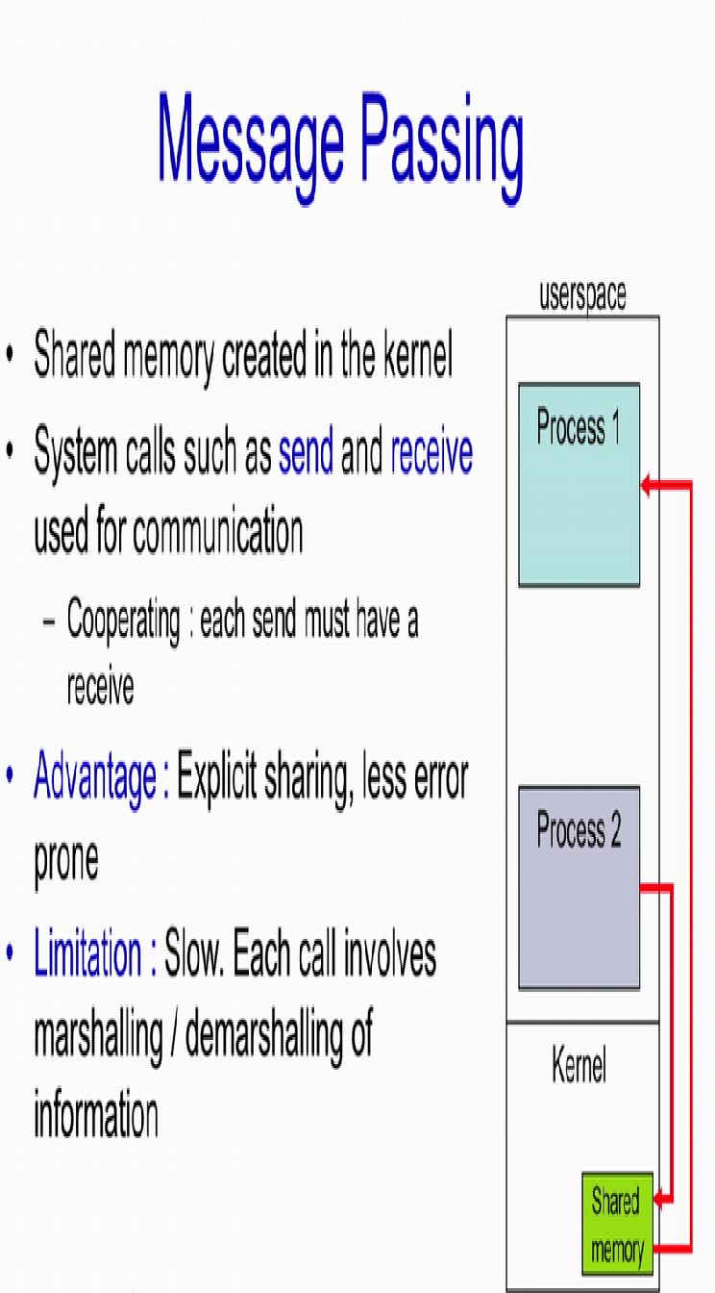
MESSAGE PASSING
A shared memory is created in the kernel
System calls used for operations:
send(message)
receive(message)
Each send should have a corresponding receive: Process Cooperation
Message can be of either fixed or variable size
Processes need to establish a communication link between them and use provided operations
Each call requires marshalling and de-marshalling of information.
Message passing is useful for exchanging smaller amounts of data

Slide 43
MESSAGE PASSING
Implementing communication link:
Physical:
Shared memory
Hardware bus
Network
Logical:
Direct or indirect
Synchronous or asynchronous
Automatic or explicit buffering

Slide 44
MESSAGE PASSING : DIRECT COMMUNICATION
Each process must have a name and used in the following manner:
send (P, message) – send a message to process P
receive(Q, message) – receive a message from process Q
Properties of communication link
Links are established automatically
Exactly one link is associated with each pair of communicating processes
Usually the link is bi-directional, but can be made unidirectional

Slide 45
MESSAGE PASSING : INDIRECT COMMUNICATION
Processes share a mailbox, also called as ports
Each mailbox has a unique id
mailboxes() are used to send or receive Messages
Properties of communication link
Share a common mailbox between processes establishes a link
Many processes can share a link
Each pair of processes may share several communication links
It can be unidirectional or bi-directional

Slide 46
MESSAGE PASSING : INDIRECT COMMUNICATION
Procedure
create a new mailbox (port)
send and receive messages through mailbox
send(A, message)—Send a message to mailbox A.
receive(A, message)—Receive a message from mailbox A.
destroy a mailbox
Example :
A, B, and C share a mailbox M1
A sends; B and C receive

Slide 47
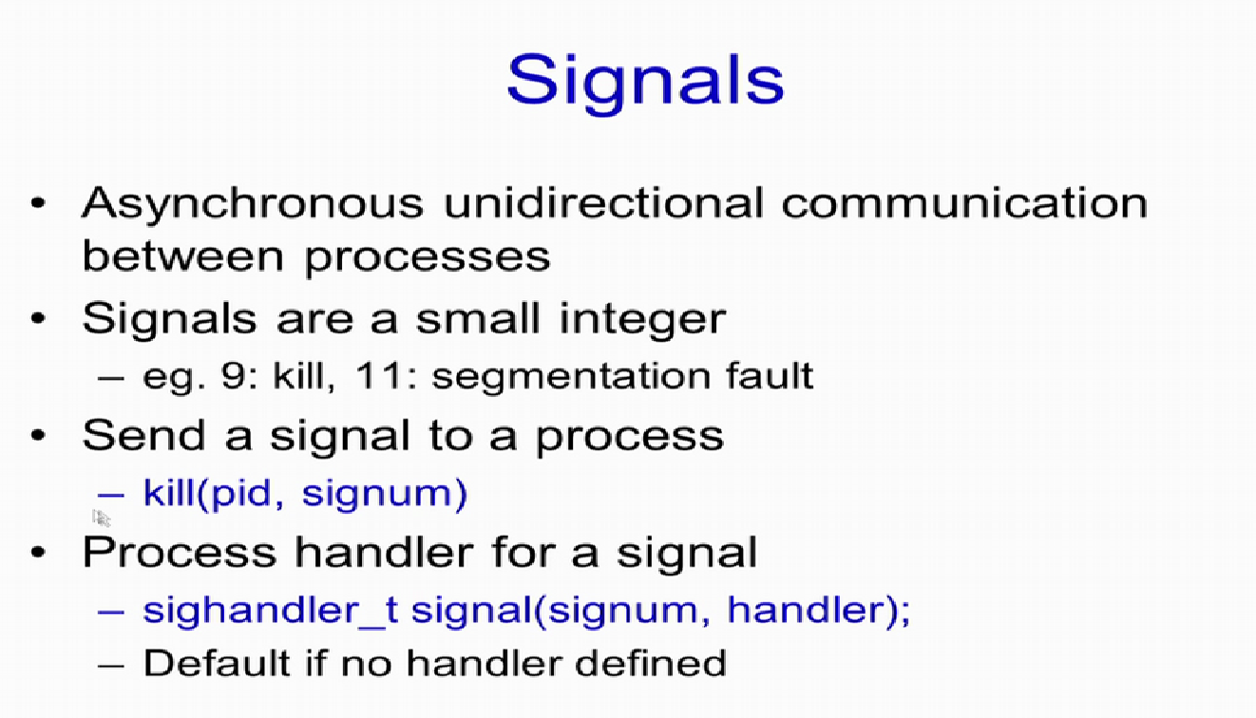

Slide 48
CLIENT-SERVER SYSTEMS: Communication
Pipes
Remote Method Invocation (Java)
Sockets
Remote Procedure Calls

Slide 49
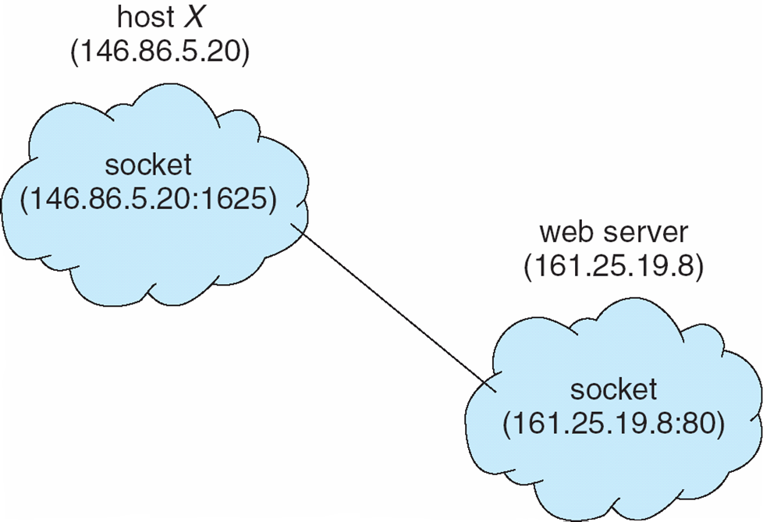
SOCKETS
Sockets: an endpoint for communication
One socket for each process
Identiﬁed by an IP address concatenated with a port number
Port no. helps in differentiating applications on a host
The socket 121.65.12.8:1428 refers to port 1428 on host 121.65.12.8
Port no.s below 1024 are well known and used for standard services
127.0.0.1 is a Special IP address (loopback) used to refer to the system on which process is running

Slide 50
REMOTE PROCEDURE CALLS
The calls between processes which are separated by networked systems
Uses ports to differentiate between services
Each message is sent to a port on the remote system.
Each message contains an identiﬁer specifying the function to execute and the parameters to pass to that function.
The function is executed and output is sent back in a separate message.
It allows a client to invoke a procedure on a remote host and gives an illusion of calling the procedure locally

Slide 51
PIPES
Following issues need to be considered while creating pipes:
There exists a relationship (i.e., parent-child) between the communicating processes?
Pipes are going to be used within a machine or over a network?
Unidirectional or bidirectional communication?
Half or full-duplex communication?
Ordinary pipes: it is created by a parent process to facilitate communication with its child process. It cannot be accessed from outside the process
Named pipes: it can be accessed without a parent-child relationship.

Slide 52
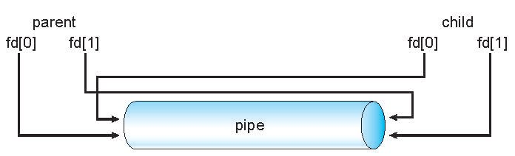
ORDINARY PIPES
Producer writes to one end (the write-end of the pipe)
Consumer reads from the other end (the read-end of the pipe)
Unidirectional
parent-child relationship is mandatory between communicating processes
In Windows, these are called anonymous pipes
Figure 3.24 from Ref.1

Slide 53
NAMED PIPES
Better than ordinary pipes
Bidirectional
Parent-child relationship is not necessary
Many processes can use it for communication
Available with both Windows systems and UNIX
Continue to exist after communicating processes have finished.
Named pipes are referred to as FIFOs in UNIX systems.
A FIFO is created with the mkfifo() system call and manipulated with the ordinary open(), read(), write(), and close() system calls.
UNIX use only half-duplex transmission
Intermachine communication needs sockets
Named pipes on Windows systems provide full-duplex communication and the communicating processes may reside on either the same or different machines.
Only byte-oriented data transmitted across a UNIX FIFO, whereas Windows systems allow either byte- or message-oriented data.

Slide 54
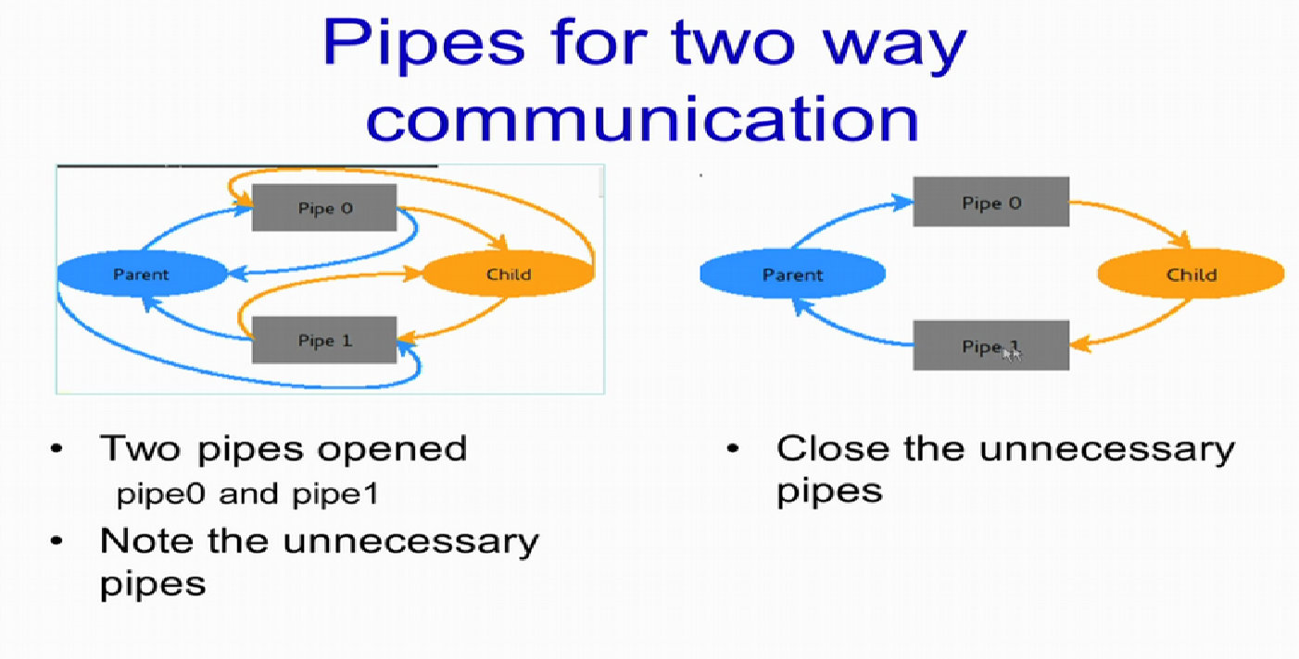

Slide 55
